Slide 1
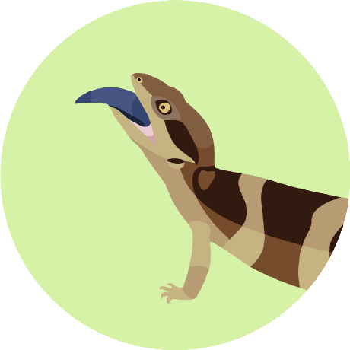


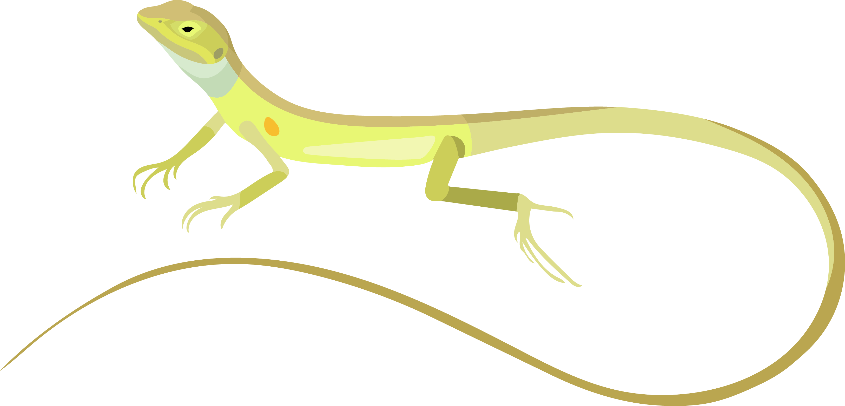
IAN BRENNAN
AUSTRALIAN
NATIONAL
UNIVERSITY
THE ADAPTIVE LANSCAPE OF AUSSIE DRAGONS
THE ADAPTIVE LANSCAPE OF AUSSIE DRAGONS

Slide 2


IAN BRENNAN
COLLABORATORS:
JANE MELVILLE NATALIE COOPER
JOANNA SUMNER
LEO TEDESCHI
LIZ BROADY
SCOTT KEOGH
AUSTRALIAN
NATIONAL
UNIVERSITY
MARIE SKŁODOWSKA CURIE ACTIONS

Slide 3
IAN BRENNAN
AUSTRALIAN
NATIONAL
UNIVERSITY
OUT OF THE TREES AND INTO THE

Slide 4
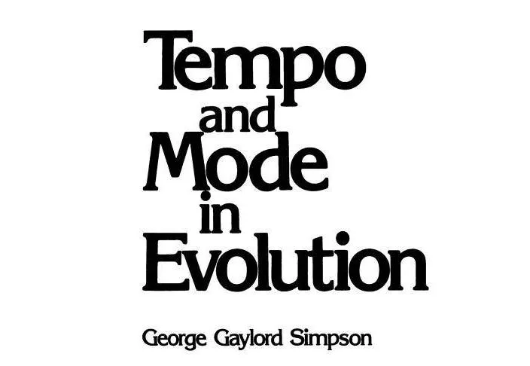
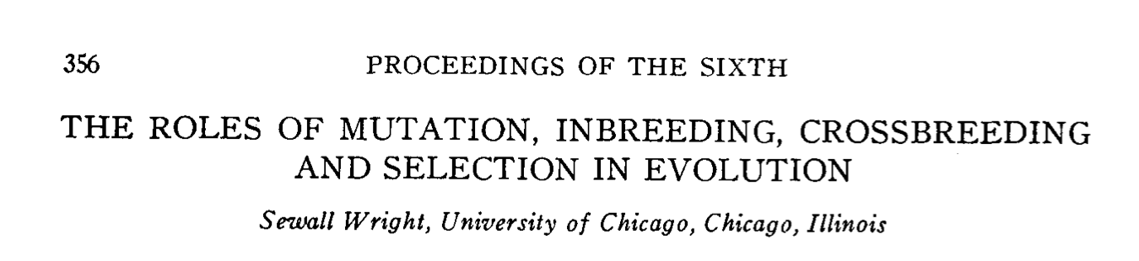
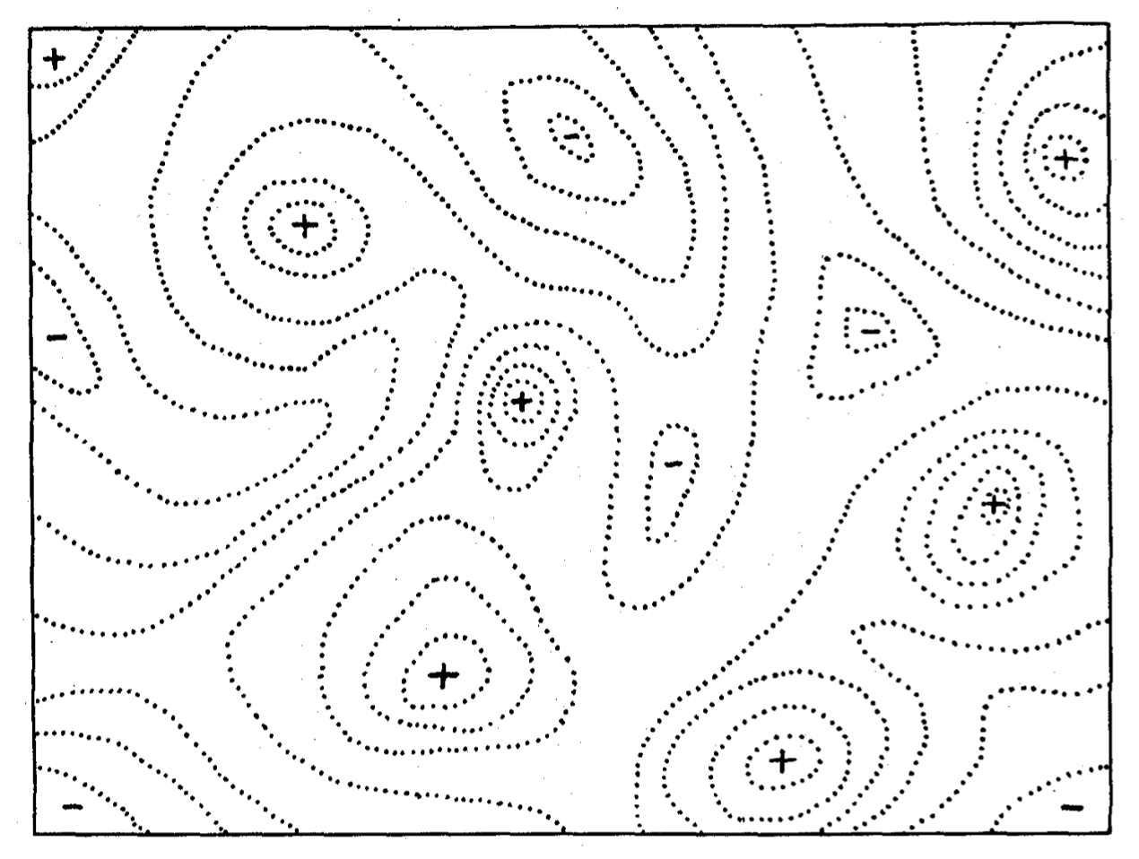
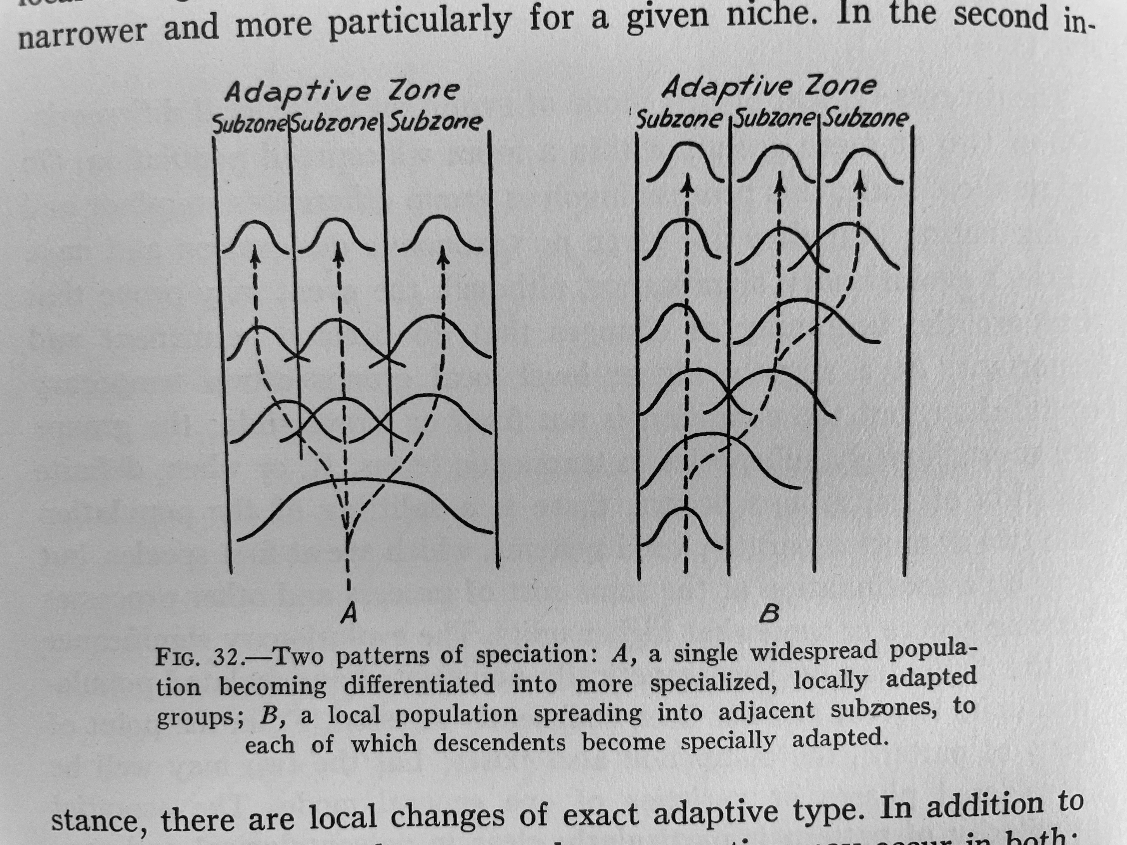

Slide 5
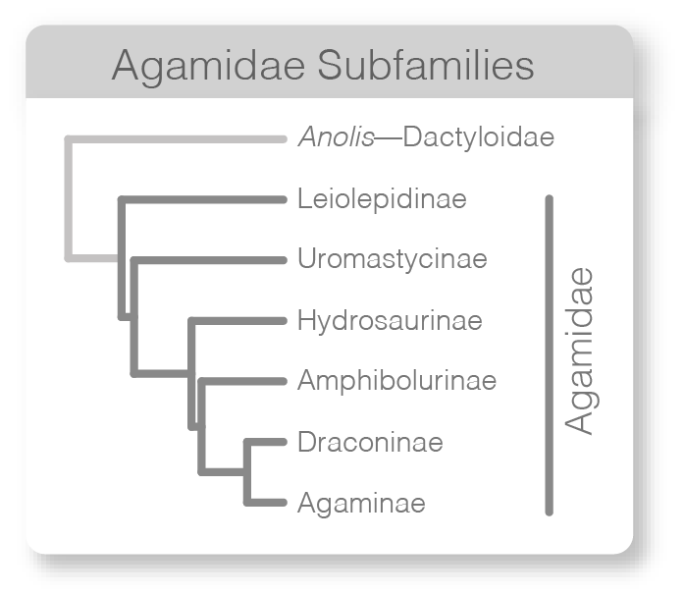
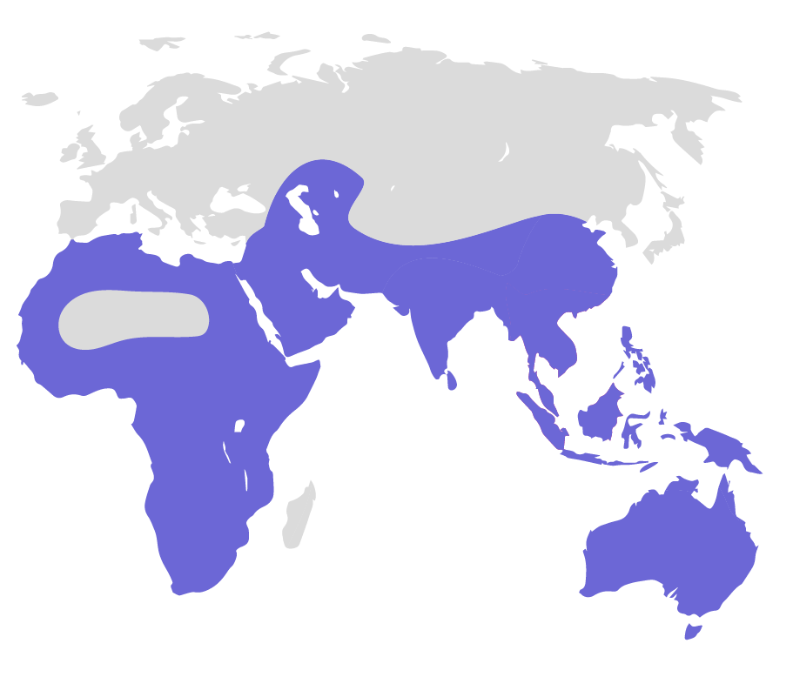
Notes:
VISIBLE GROUP OF DIURNAL IGUANIANS

Slide 7
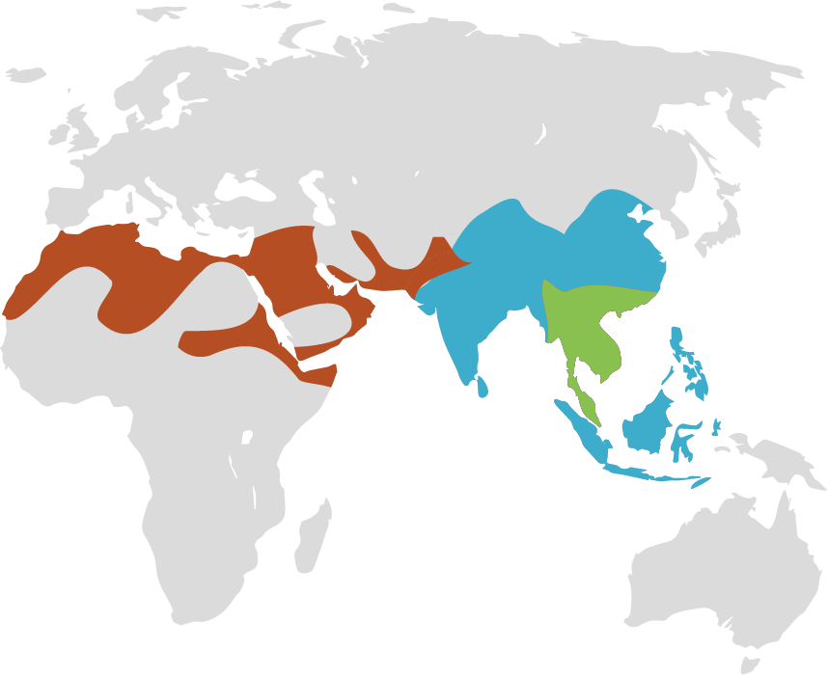
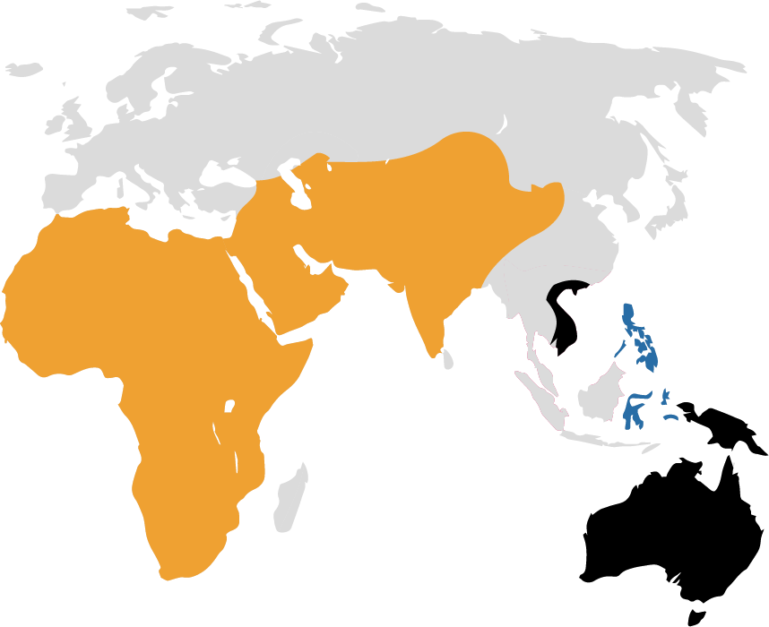

Slide 8
❶
BUILD A TREE OF THE AMPHIBOLURINAE

Slide 9
❶
BUILD A TREE OF THE AMPHIBOLURINAE
❷
EXPLORE THEIR MORPHOLOGICAL EVOLUTION

Slide 10



Slide 11
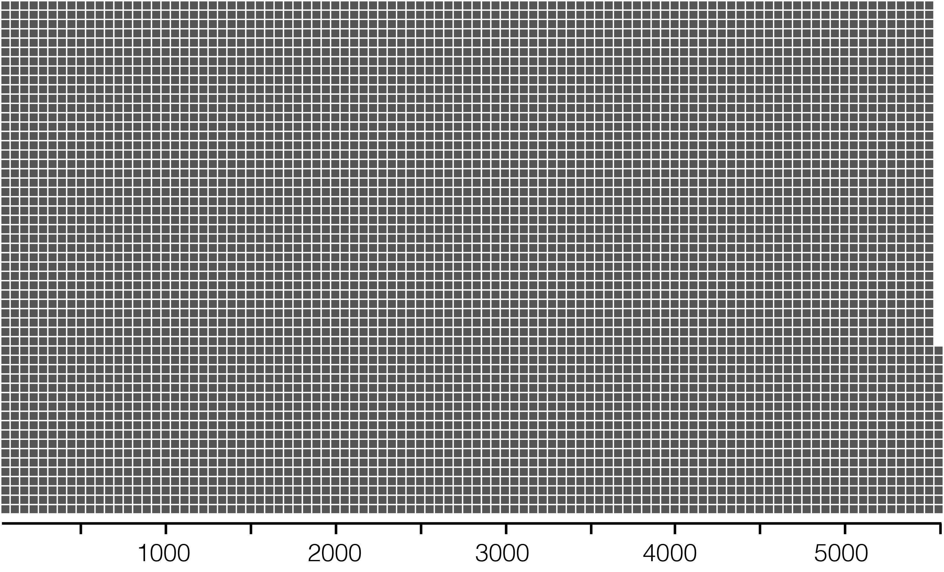
=
1 LOCUS

Slide 12
=
1 LOCUS
5,440 TOTAL LOCI

Slide 13

=
1 LOCUS
5,440 TOTAL LOCI
5,440 GENE TREES

Slide 14
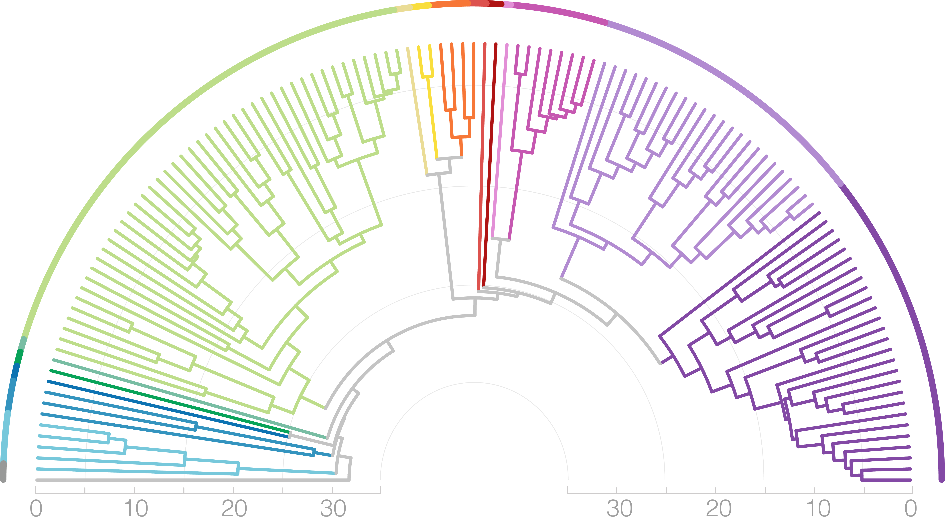
=
1 LOCUS
5,440 TOTAL LOCI
5,440 GENE TREES
1 SPECIES TREE

Slide 15
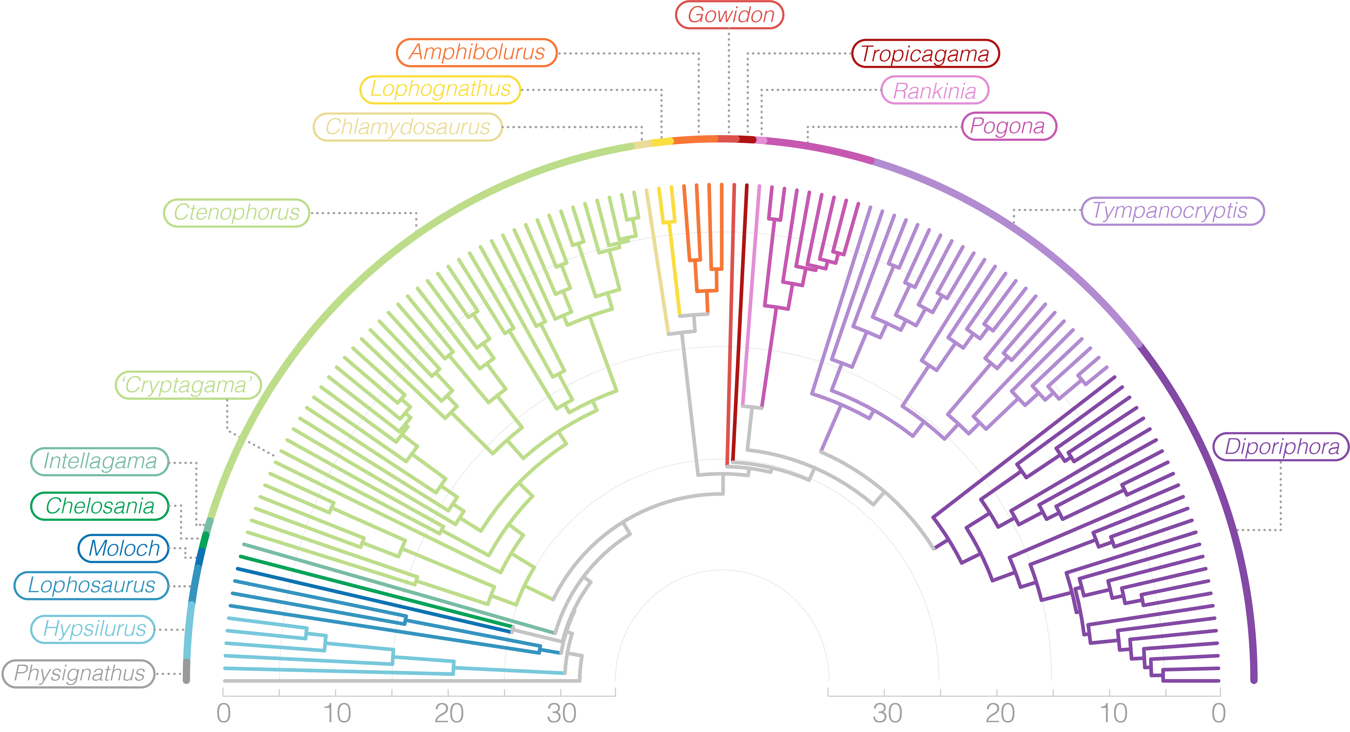

Slide 16
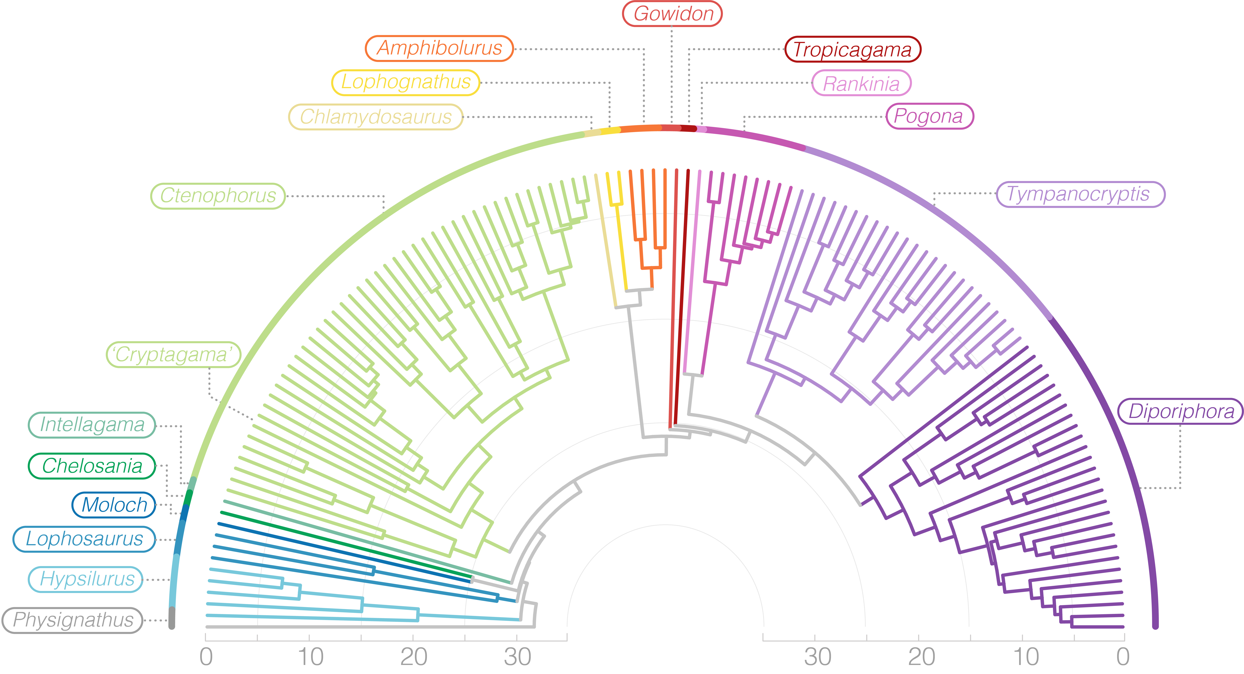

Slide 17
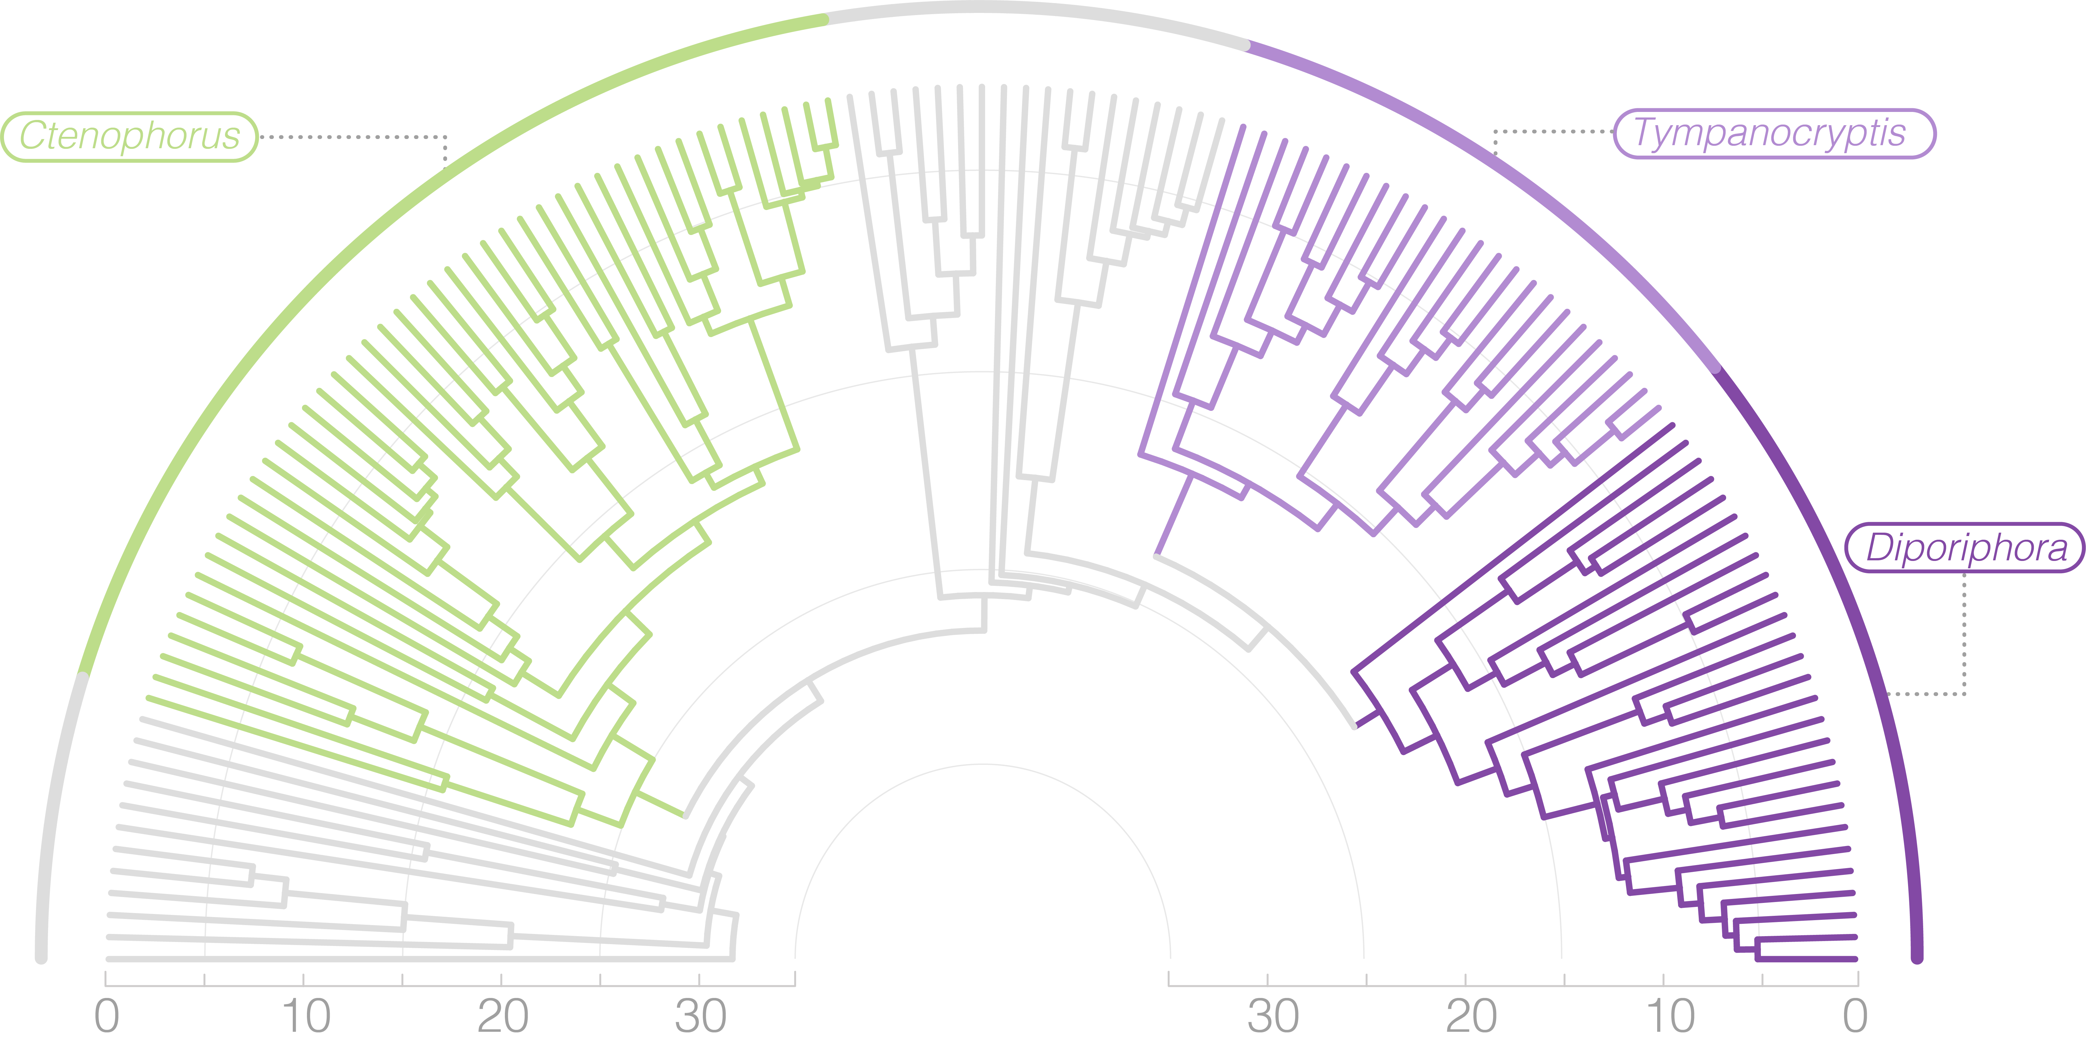
RICHNESS CONCENTRATED IN 3 GENERA

Slide 18
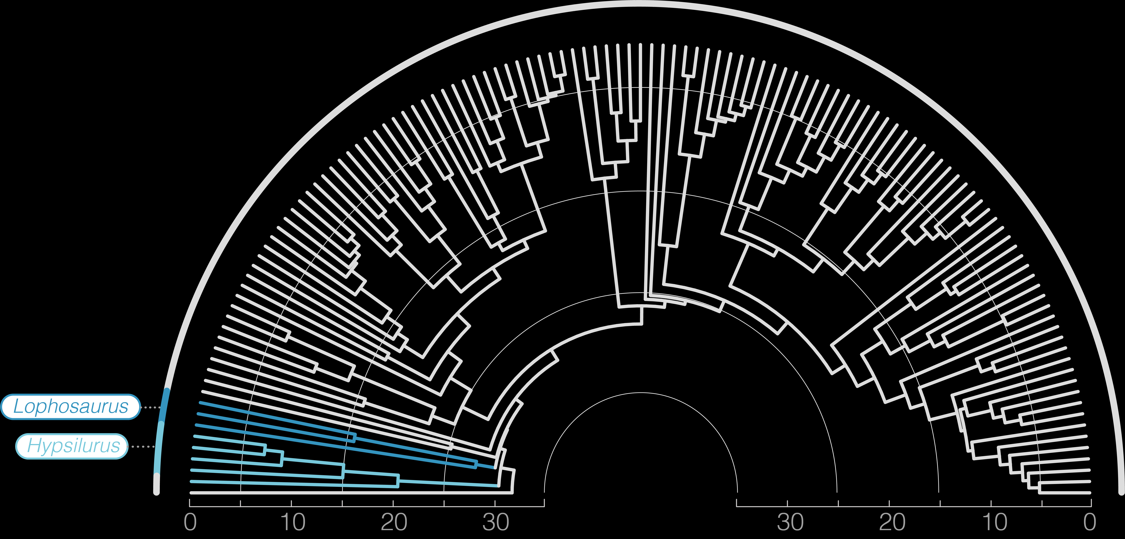
TREE DRAGONS ARE NOT A CLADE

Slide 19
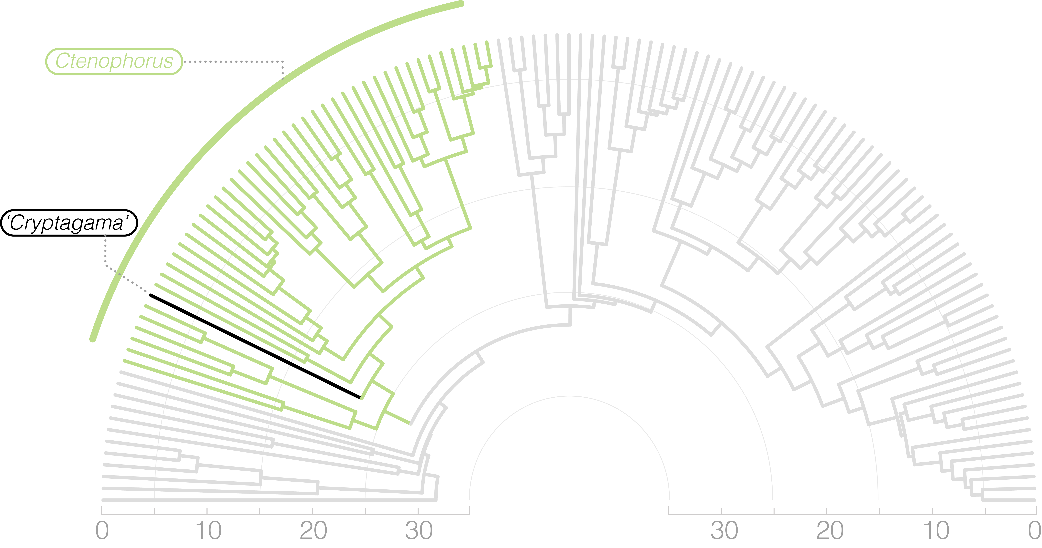
CRYPTAGAMA IS CTENOPHORUS

Slide 20
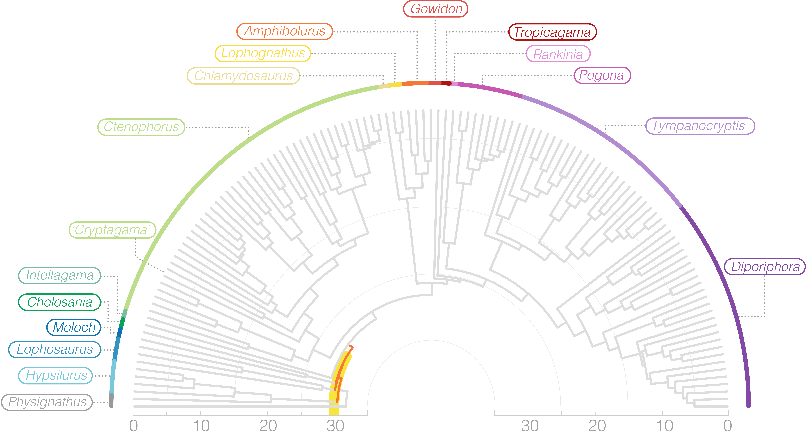
RAPID EARLY RADIATION

Slide 21









Slide 22


Slide 23
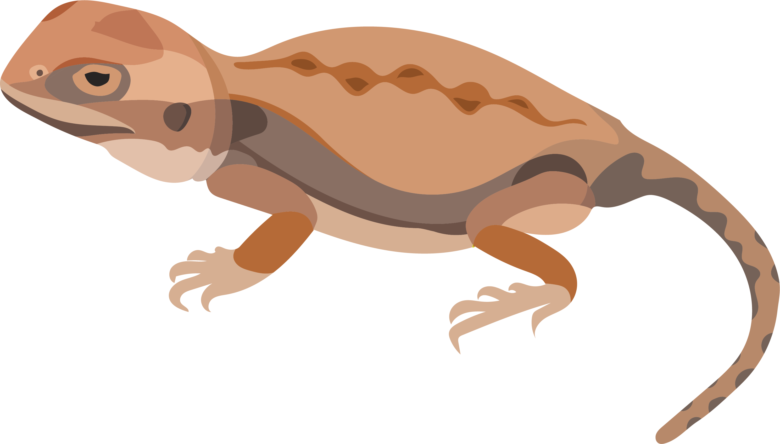
40 mm

Slide 24
80 mm

Slide 25
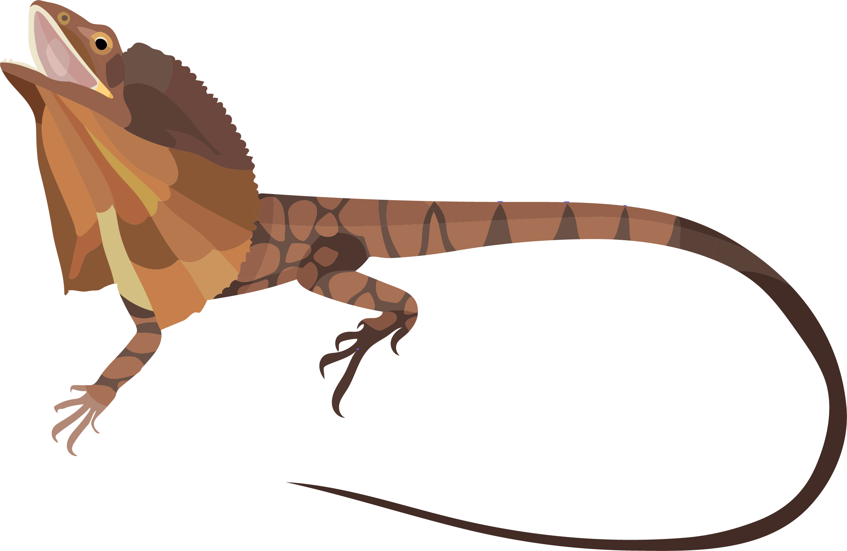
250 mm

Slide 26
250 mm
HOW DOES
VARIATION
EVOLVE?
◼︎ ◉ ▲

Slide 27
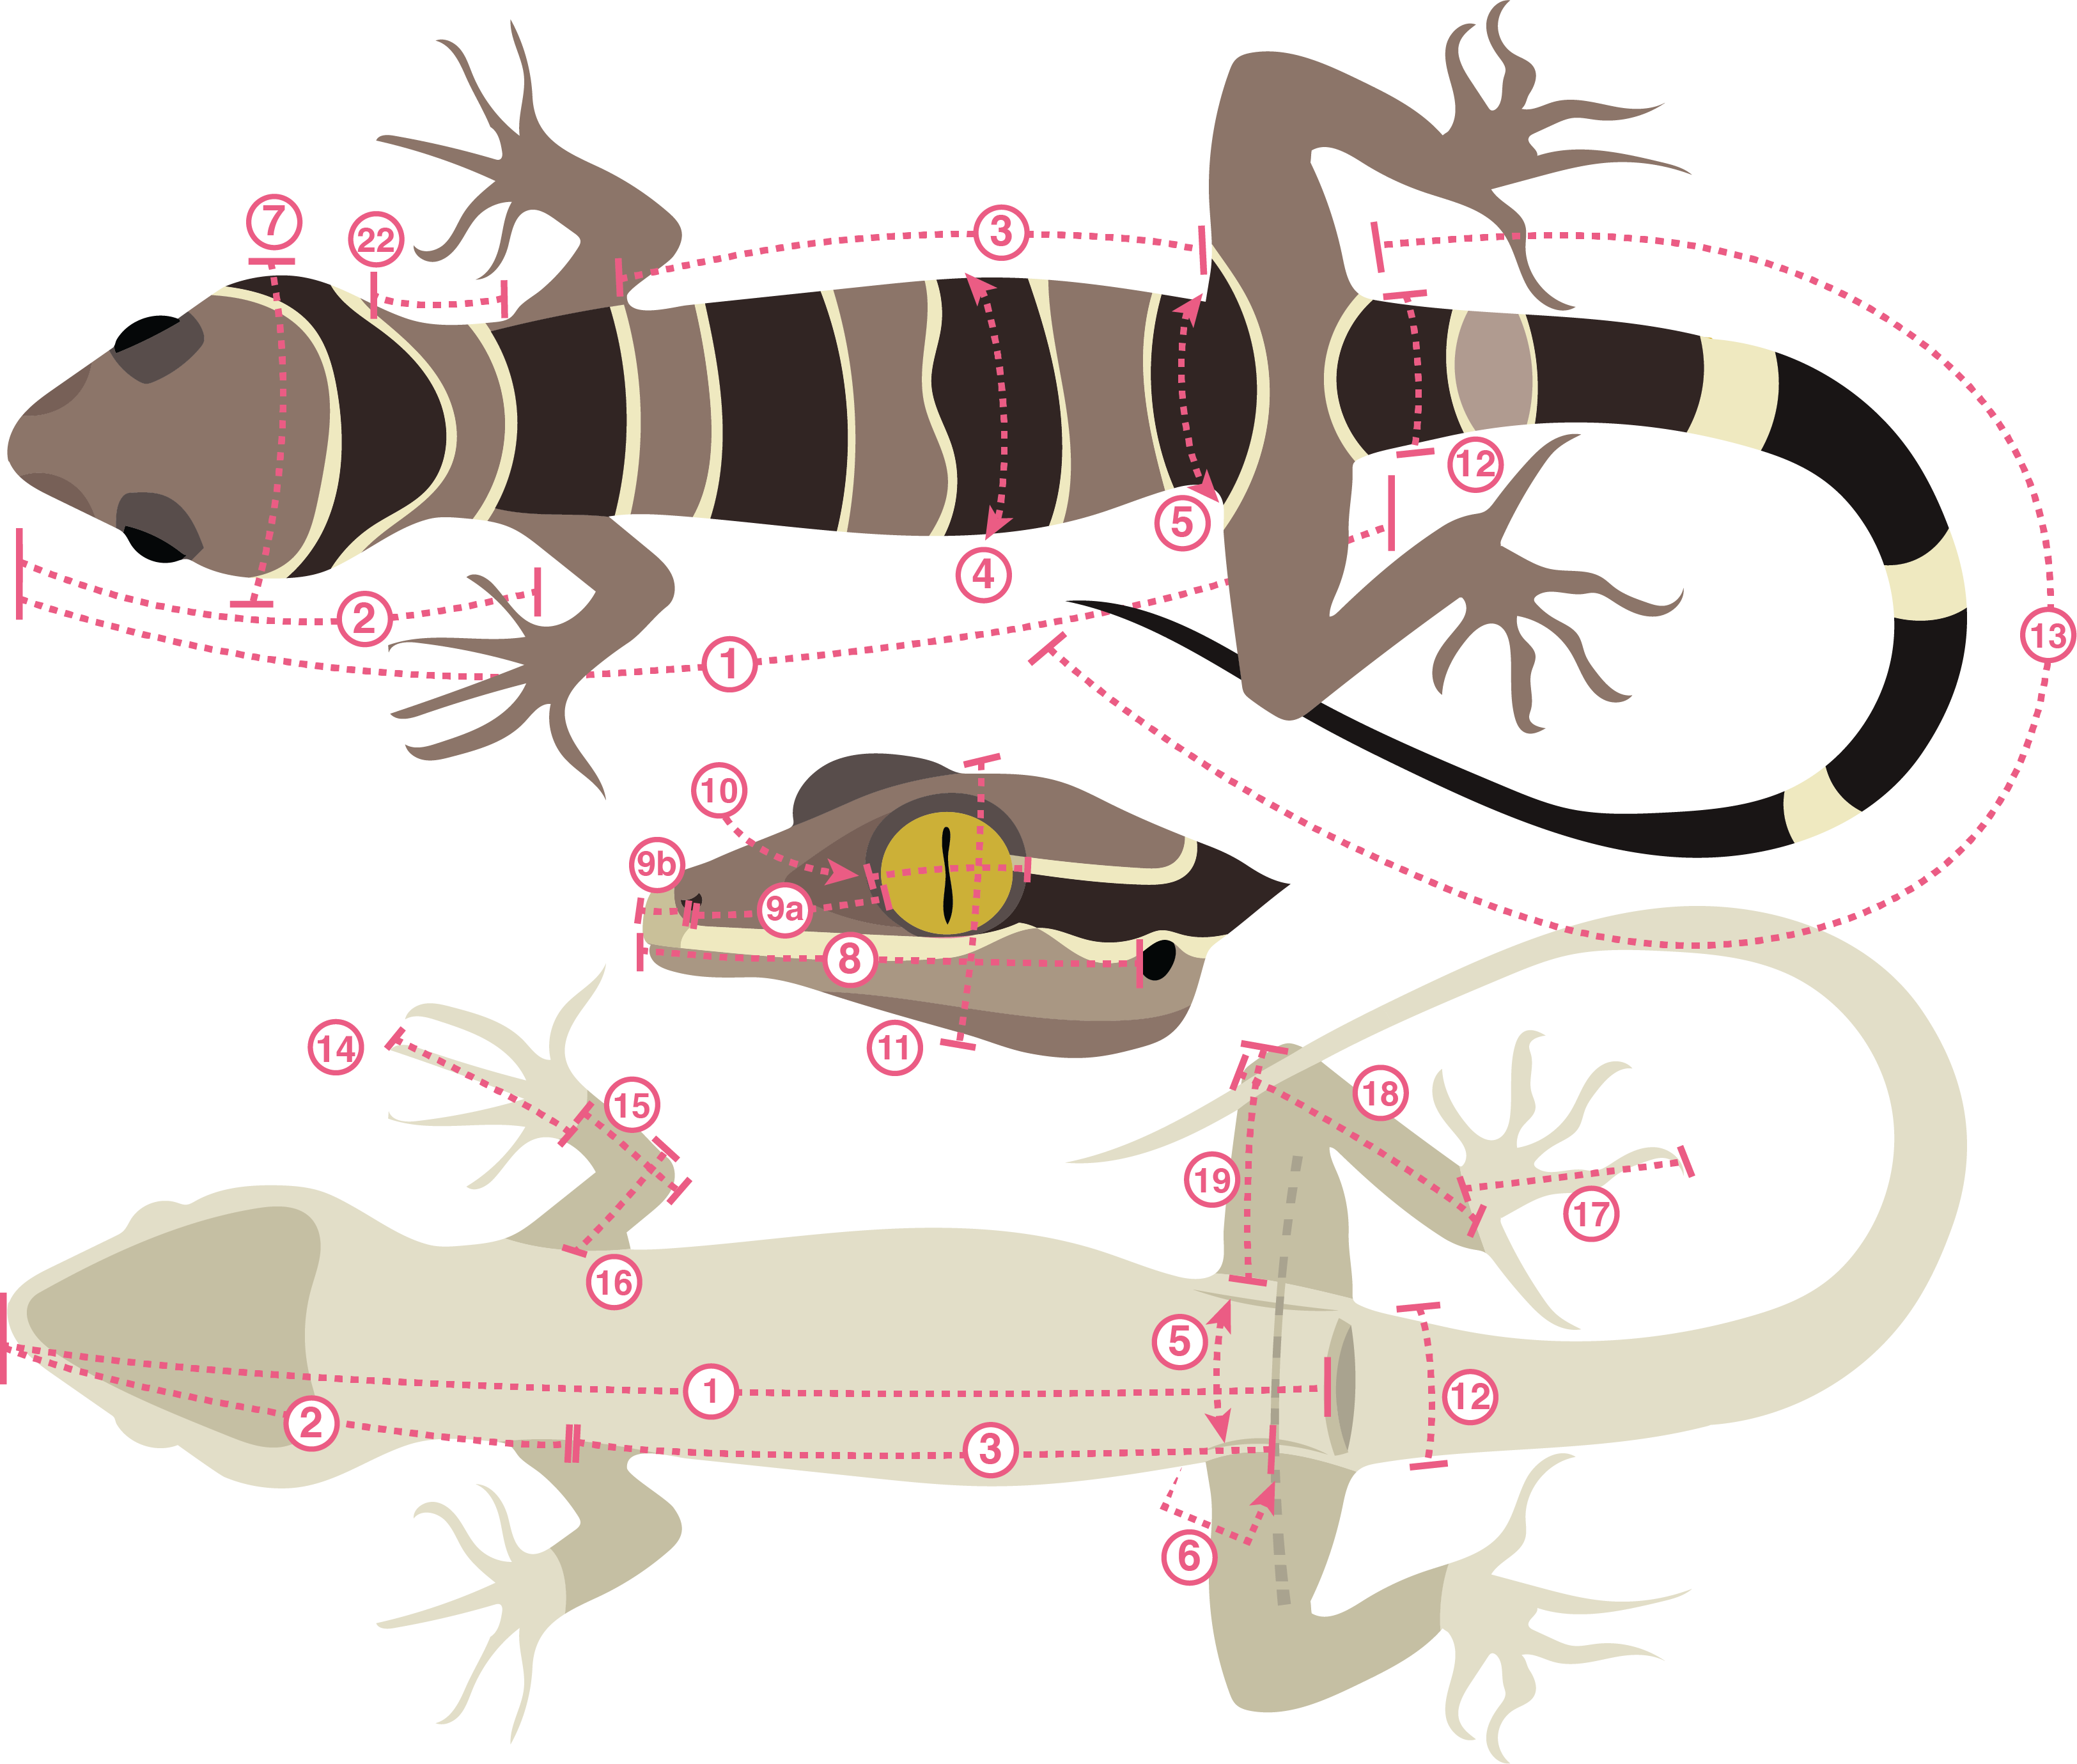
21 MEASUREMENTS FROM 480+ SPECIMENS

Slide 28
21 MEASUREMENTS FROM 480+ SPECIMENS
120+ SPECIES

Slide 29
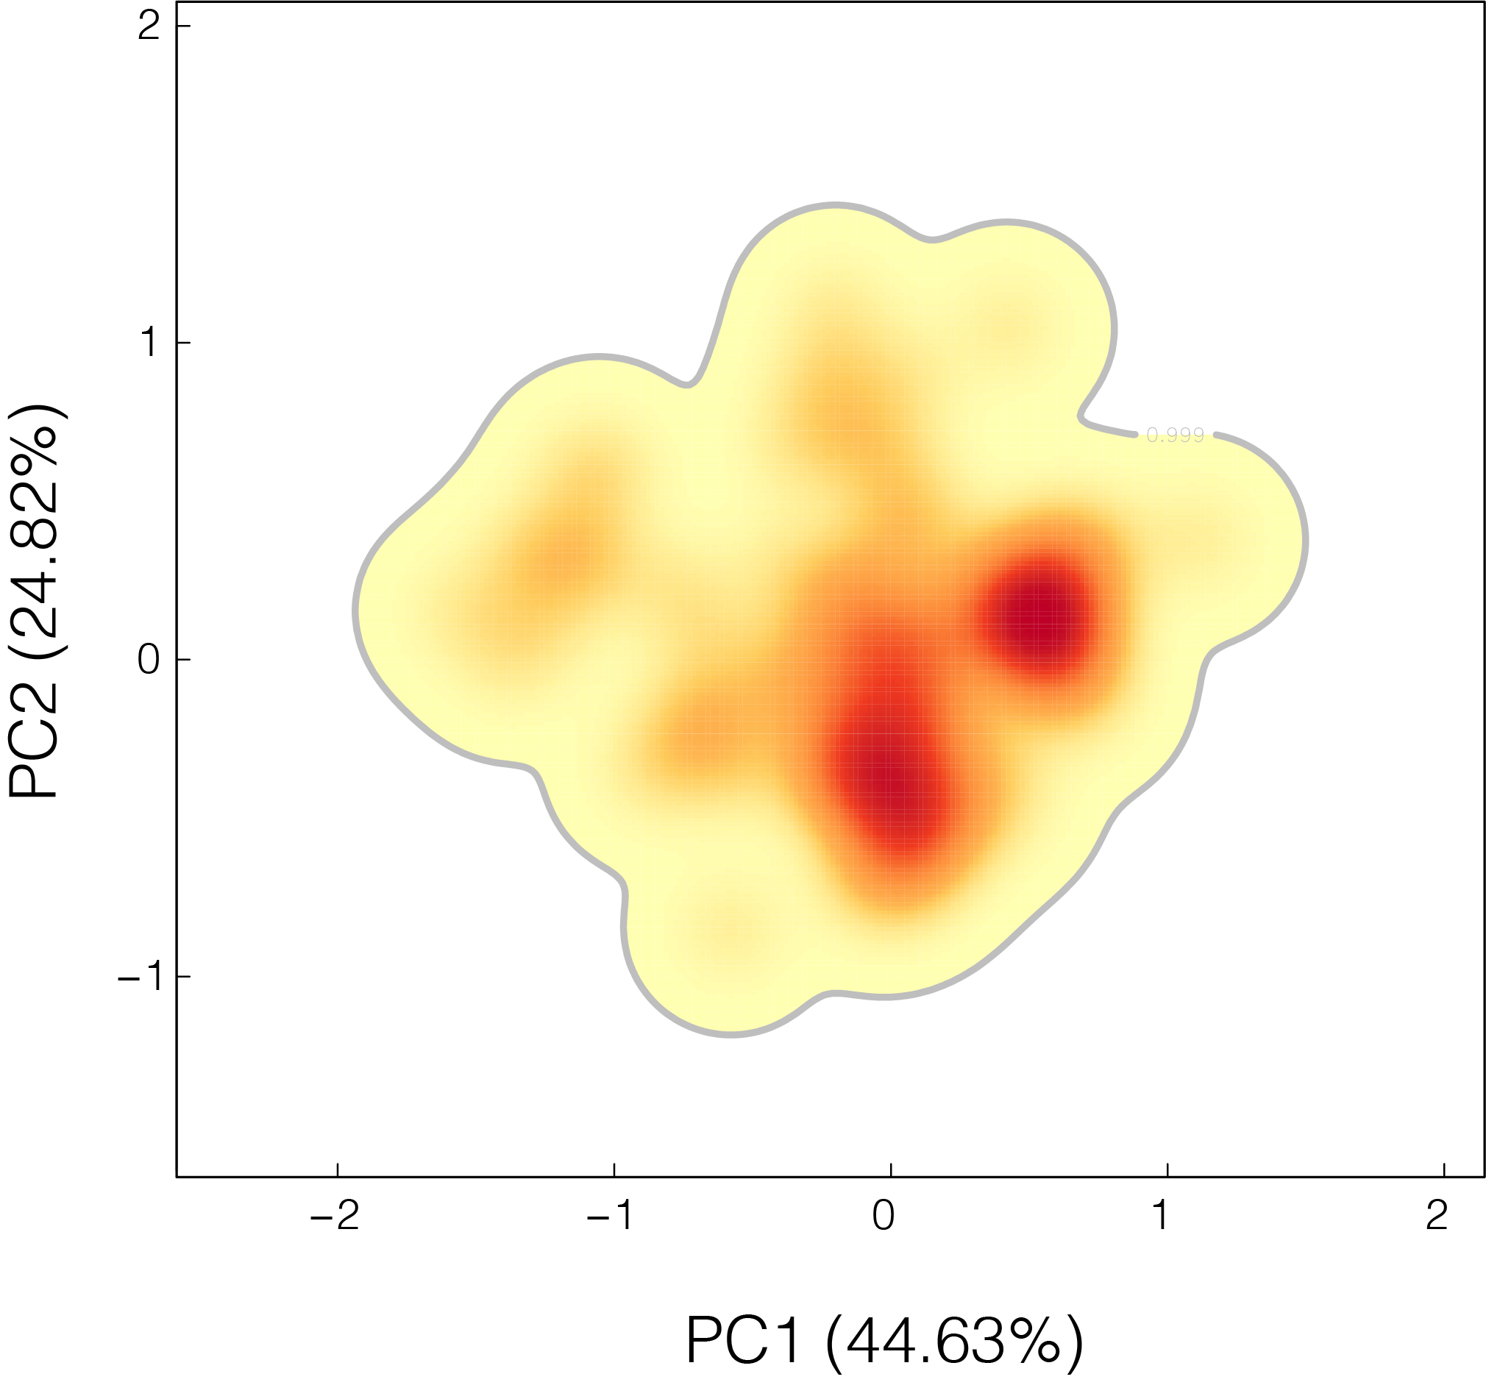
Notes:
HIGHLY MULTIDIMENSIONAL SPACES ARE HARD TO VISUALIZE, SO WE CAN REDUCE IT USING PCA AND IDENTIFY MAJOR AXES OF VARIATION

Slide 30
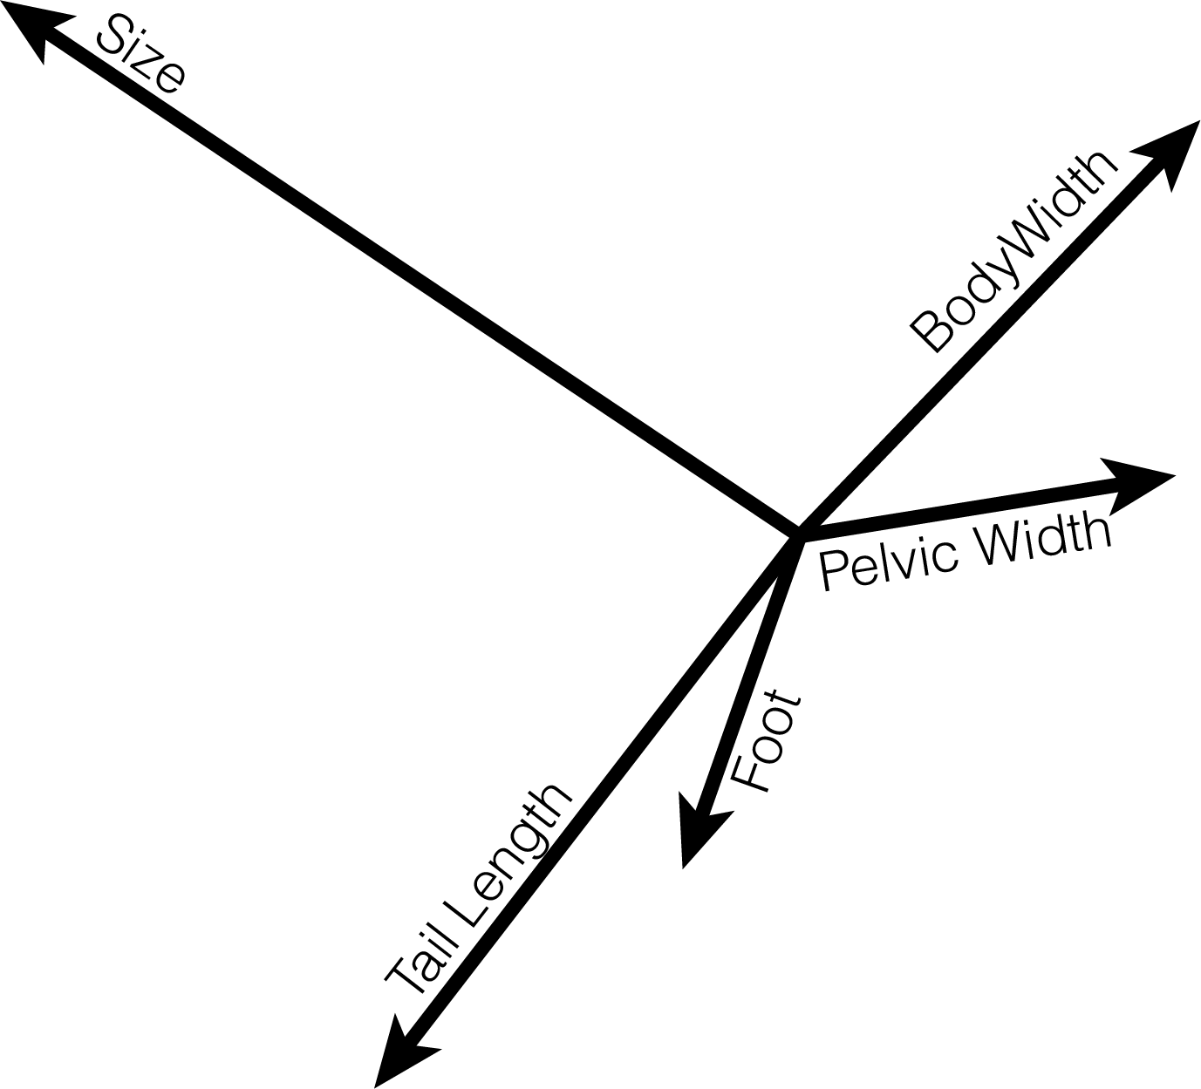

Slide 32
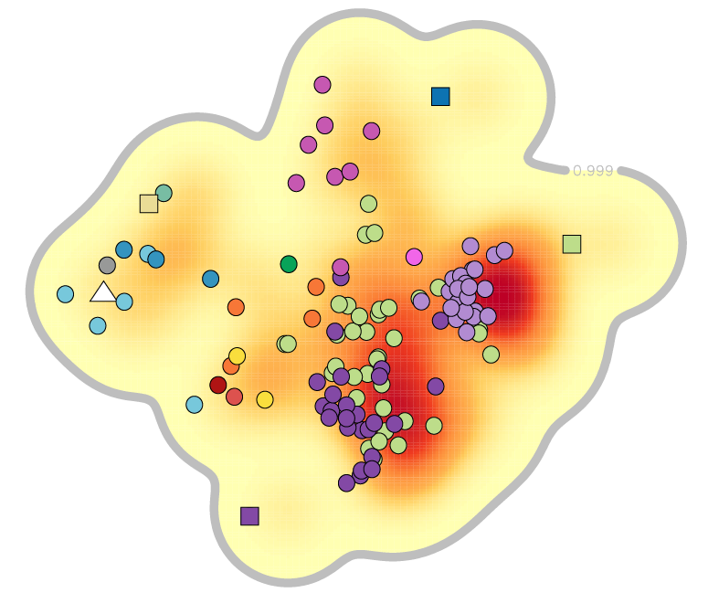
HOW MANY PEAKS IN THE LANDSCAPE?

Slide 33
HOW MANY PEAKS IN THE LANDSCAPE?
HOW DO SPECIES
MATCH TO PEAKS?

Slide 34
HOW MANY PEAKS IN THE LANDSCAPE?
HOW DO SPECIES
MATCH TO PEAKS?
DO ANCESTORS
MATCH TO PEAKS?

Slide 35
HOW MANY PEAKS IN THE LANDSCAPE?
HOW DO SPECIES
MATCH TO PEAKS?
DO ANCESTORS
MATCH TO PEAKS?
WHAT’S THE PATH TO NEW PEAKS?

Slide 36
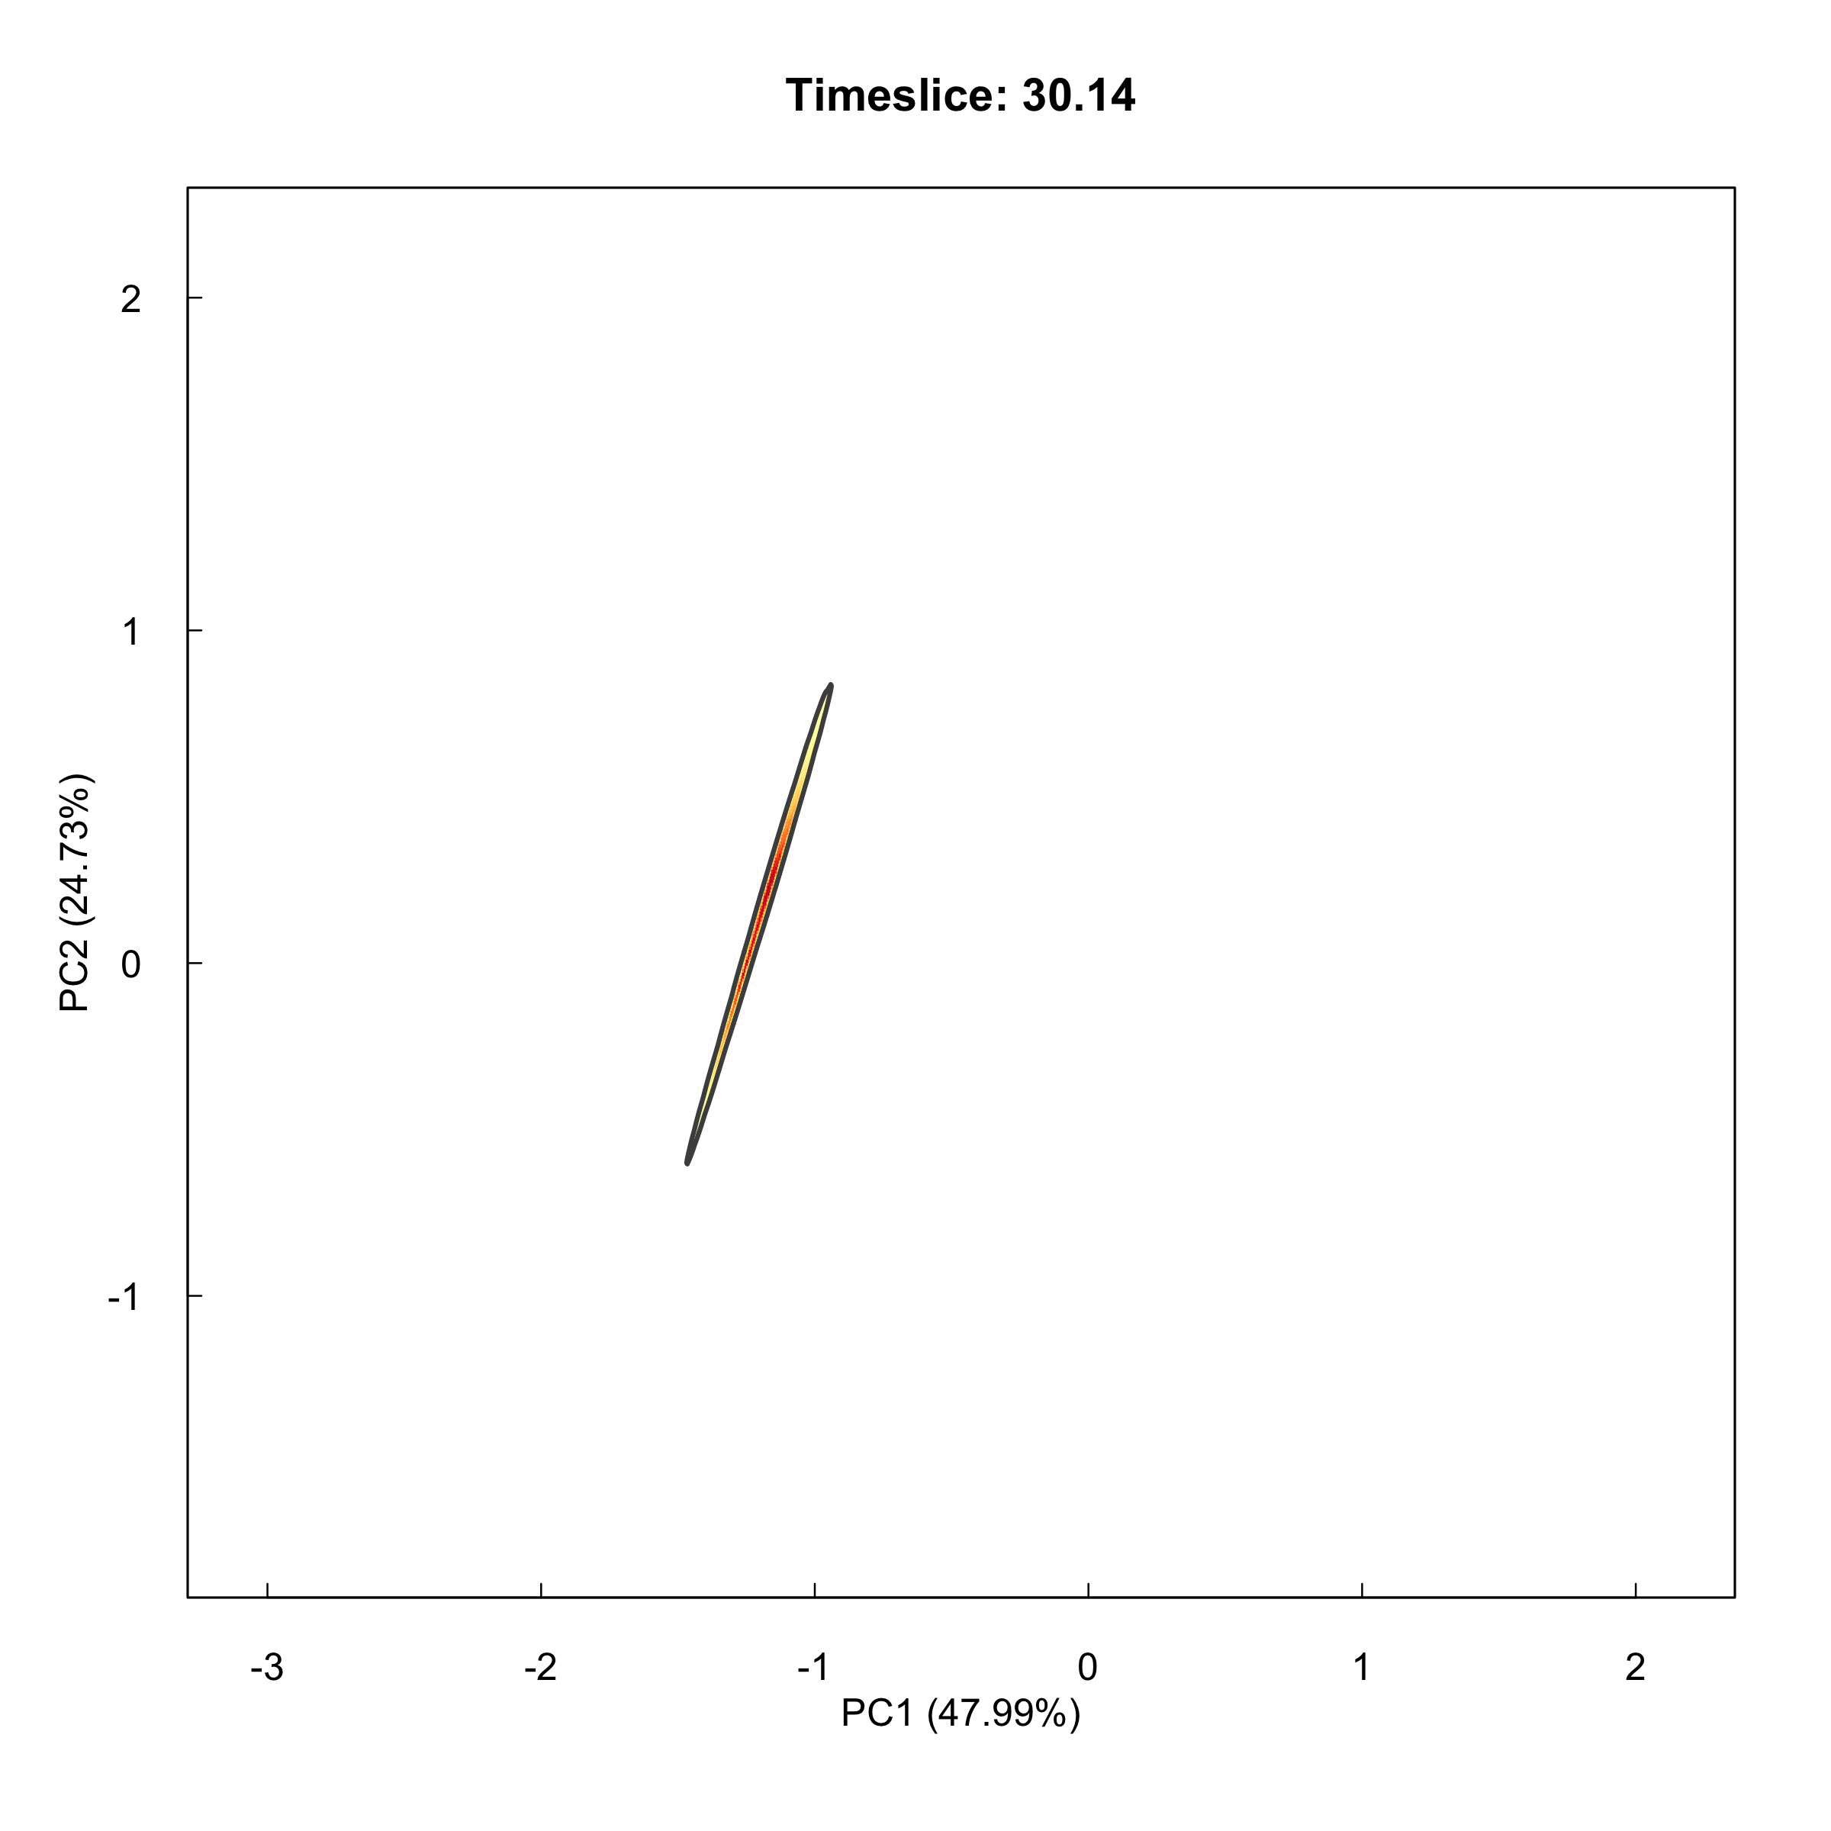

Slide 37
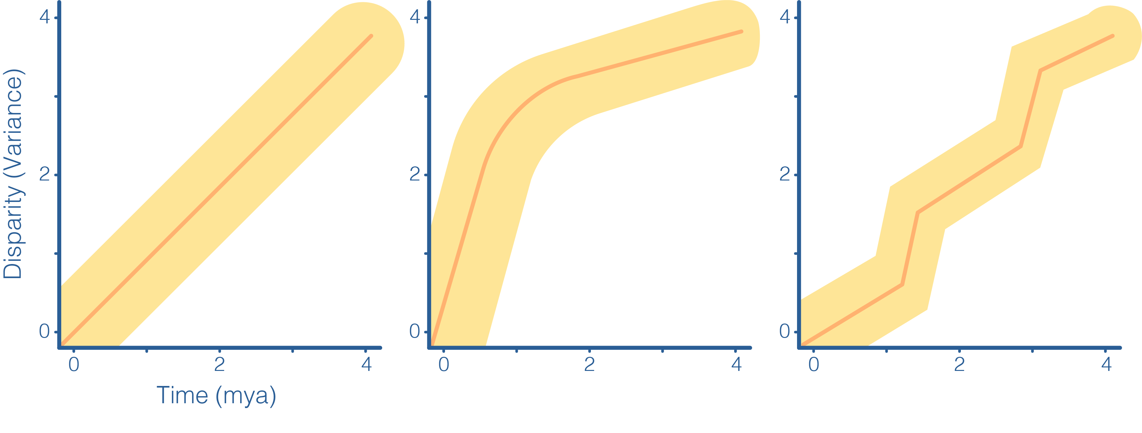
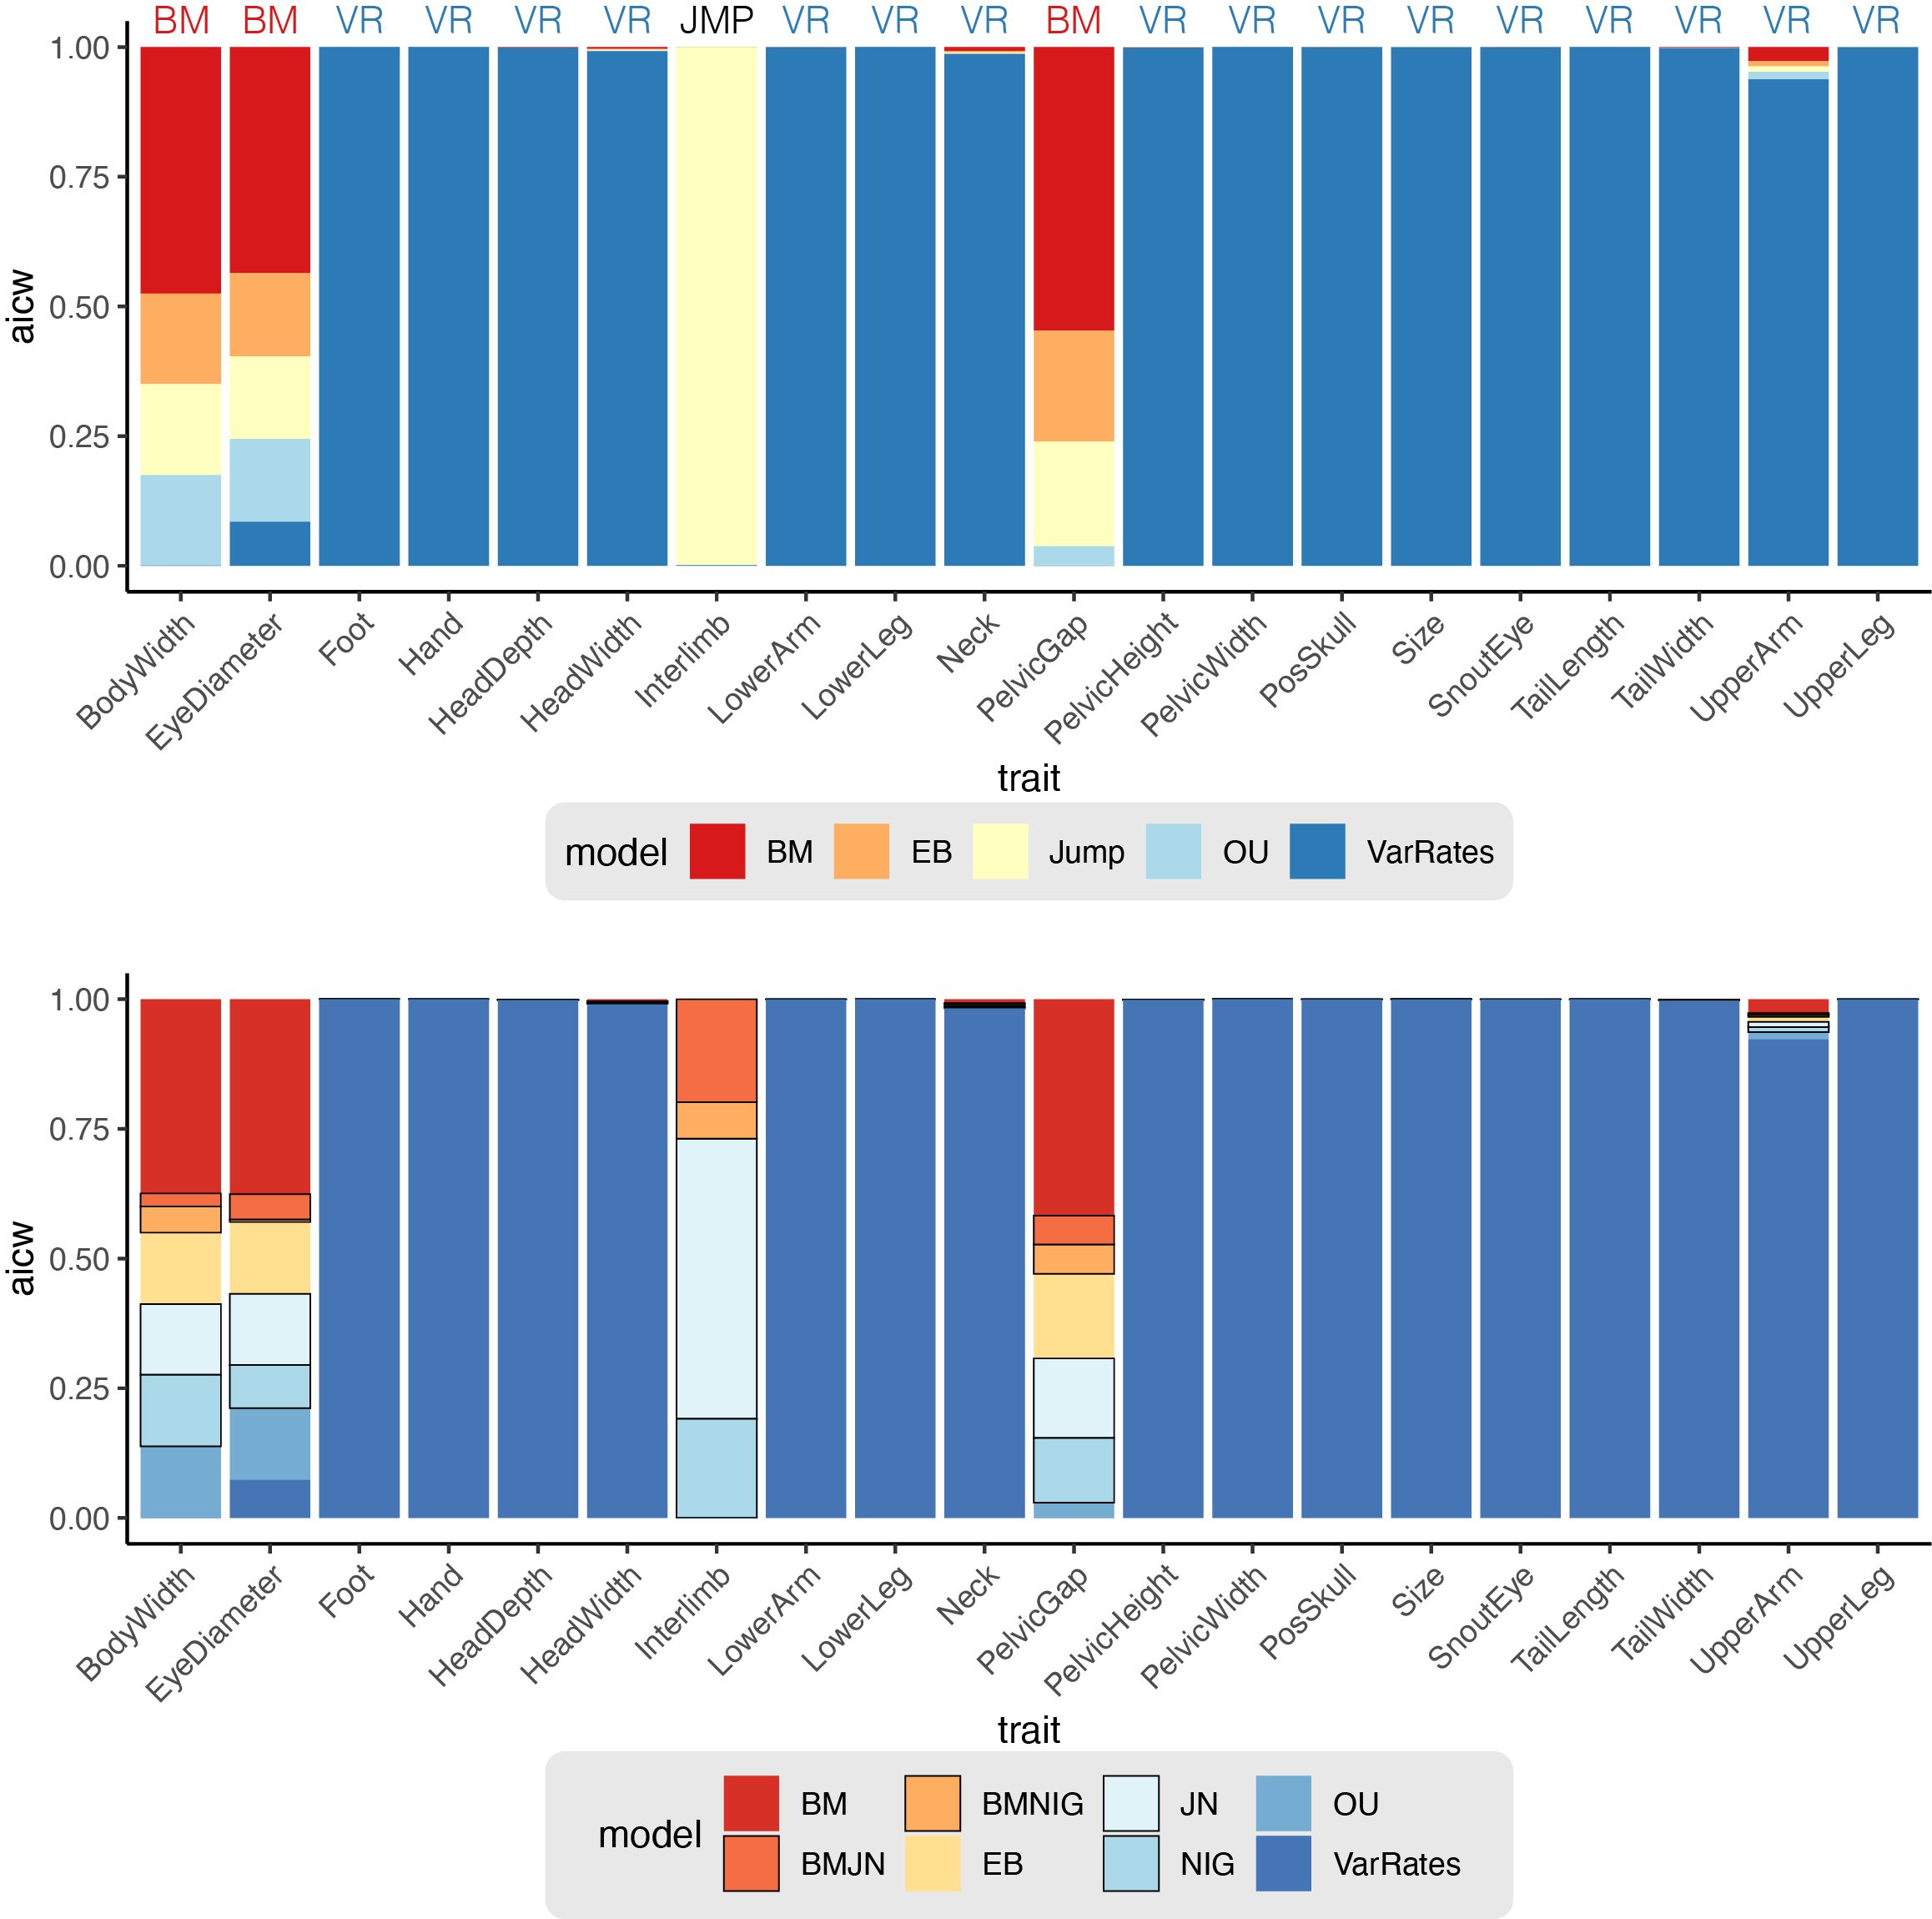
TRAIT MODEL FITTING SUPPORTS BRANCH-SPECIFIC RATES
GRADUAL—BM
Notes:
WE CAN FIT NULL AND INCREASINGLY COMPLEX MODELS OF TRAIT EVOLUTION

Slide 38
TRAIT MODEL FITTING SUPPORTS BRANCH-SPECIFIC RATES
GRADUAL—BM
EARLY—EB

Slide 39
TRAIT MODEL FITTING SUPPORTS BRANCH-SPECIFIC RATES
GRADUAL—BM
EARLY—EB
VARIABLE—VR

Slide 40
TRAIT MODEL FITTING SUPPORTS BRANCH-SPECIFIC RATES
GRADUAL—BM
EARLY—EB
VARIABLE—VR

Slide 41
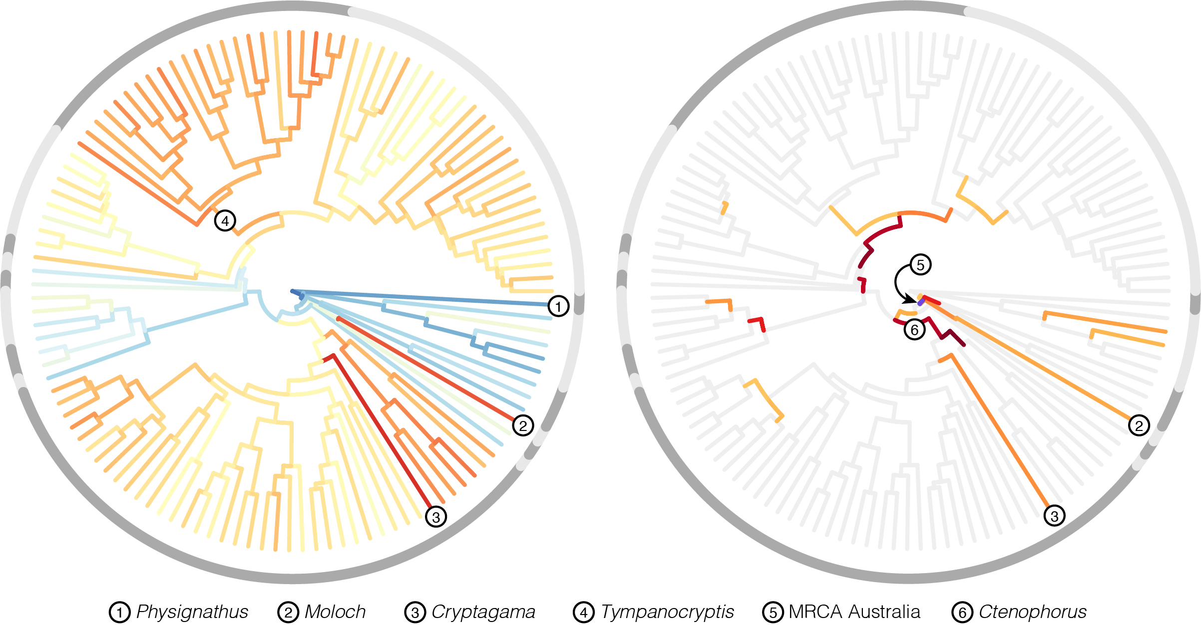
DISTANCE FROM MRCA
Notes:
From trait fitting we can estimate internal nodes and we start to develop a picture of what ancestral dragons looked like. We also can identify how far some species have evolved away from that ancestor.

Slide 42
DISTANCE FROM MRCA
EXCEPTIONAL CHANGE
Notes:
WE CAN ALSO IDENTIFY WHERE THE MAJORITY OF MORPHOLOGICAL CHANGE IS CONCENTRATED.
THE GREATEST DEPARTURE FROM OUR NULL MODEL OCCURS AT THE BASE OF THE AUSTRALIAN CLADE, SUGGESTING A PARADIGM SHIFT IN THE MORPHOLOGICAL EVOLUTION OF DRAGONS WHEN THEY COLONIZED AUSTRALIA

Slide 43
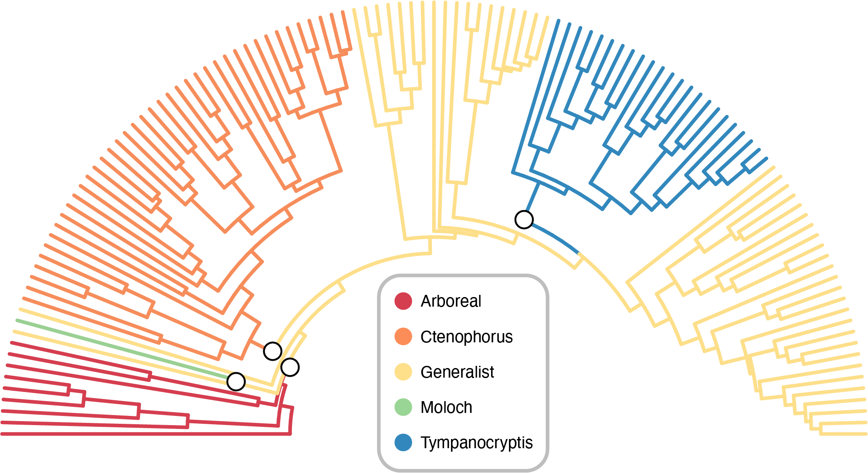
HOW MANY PEAKS IN THE LANDSCAPE?

Slide 44
MULTI OPTIMA OU MODELS
5 PEAKS

Slide 45
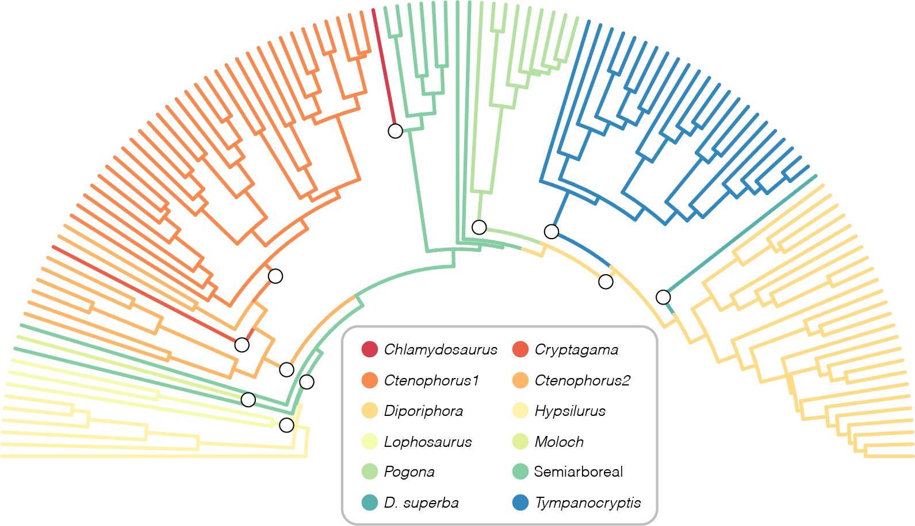
MULTI OPTIMA OU MODELS
12 PEAKS
Notes:
THE 5 PEAK SCENARIO IS ENTIRELY NESTED WITHIN THE 12 PEAK, SO THIS IS REALLY JUST SPLITTING CLUSTERS MORE FINELY. KINDA LIKE LOCAL OPTIMA ON A LARGER REGIONAL OPTIMUM.

Slide 46
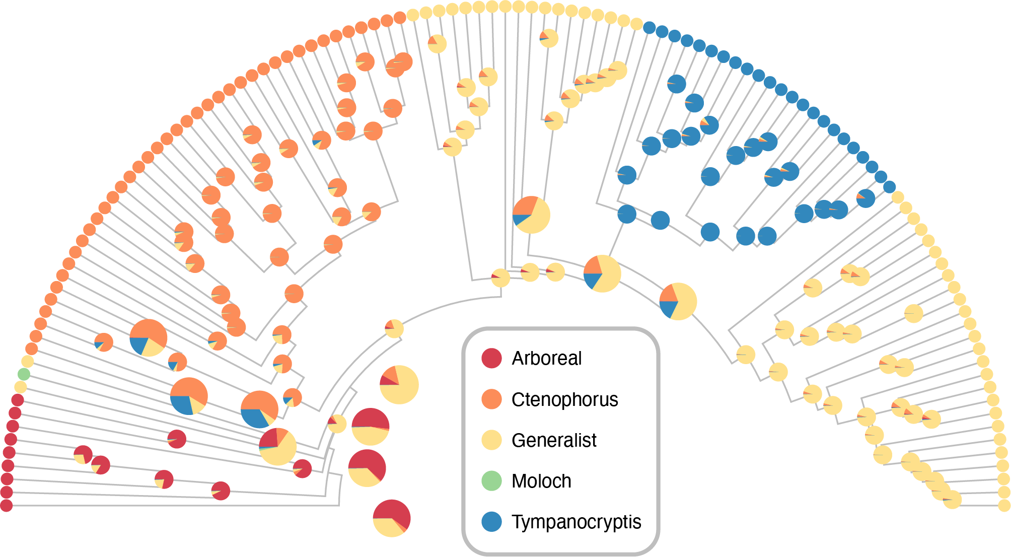
DO ANCESTORS
MATCH TO PEAKS?

Slide 47
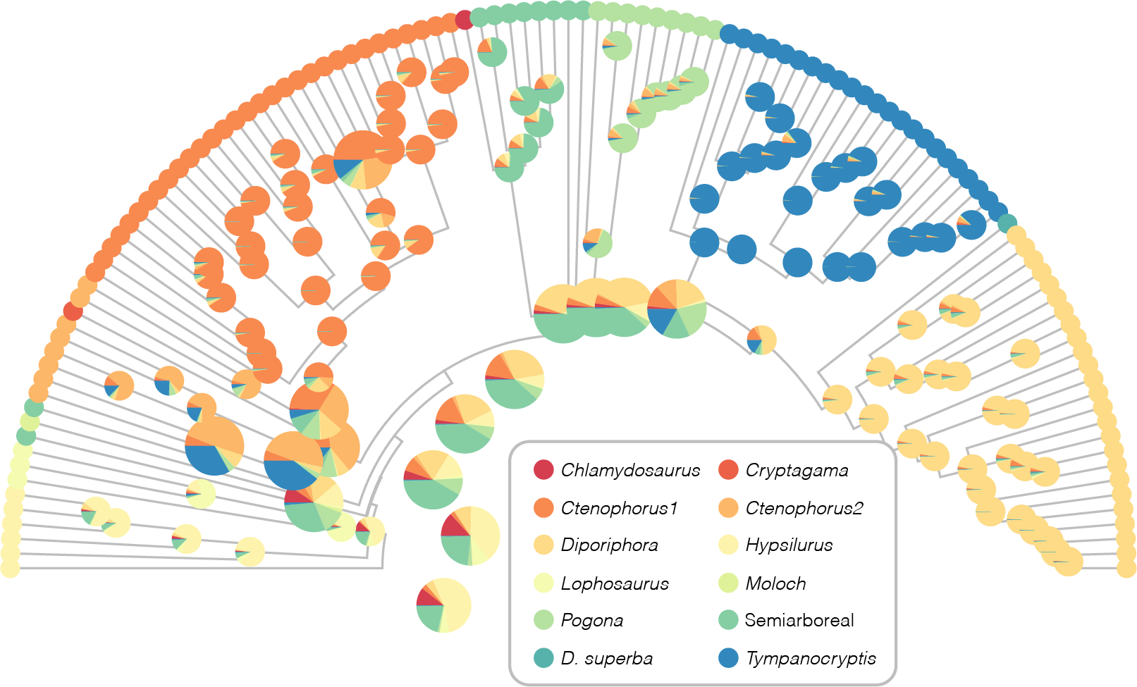
RANDOM FOREST CLASSIFICATIONS
12 PEAKS

Slide 48
RANDOM FOREST CLASSIFICATIONS
5 PEAKS

Slide 49
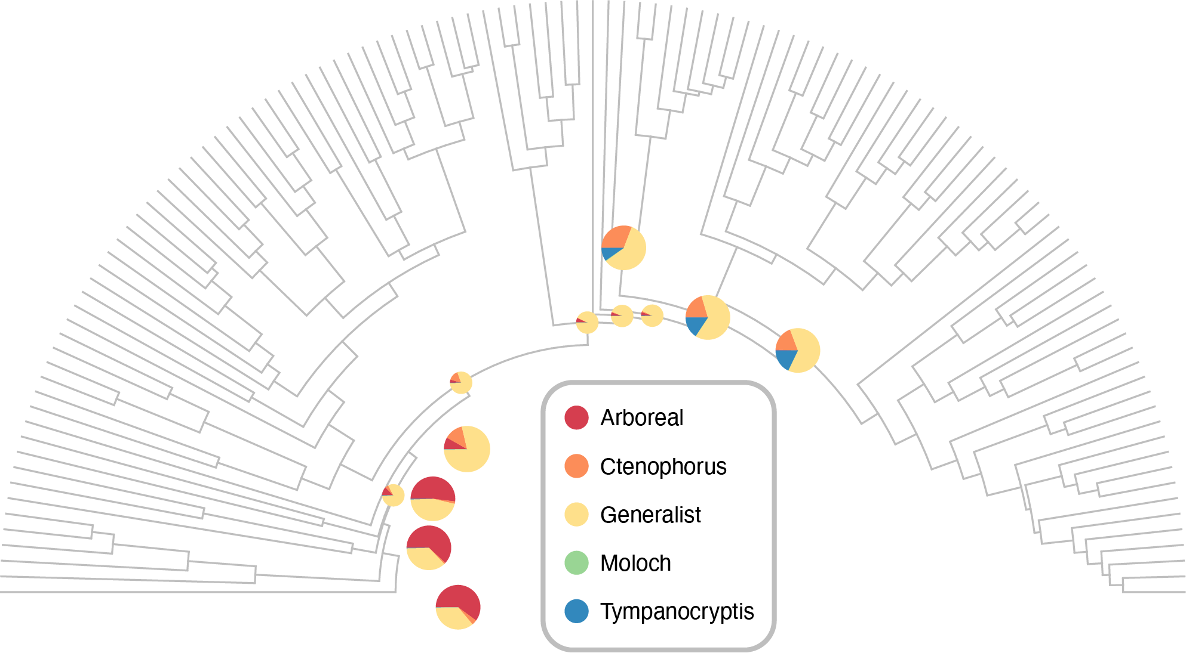
RANDOM FOREST CLASSIFICATIONS
5 PEAKS

Slide 50

HOW DO WE GET
FROM THIS

Slide 51
HOW DO WE GET
FROM THIS → TO THIS
?

Slide 52

RANDOM FOREST CLASSIFICATIONS
5 PEAKS
Notes:
ARBOREAL FOREST DWELLING ANCESTOR COLONIZES AUSTRALIA, COMES OUT OF THE TREES, BECOMES GENERALIST, AND COLONIZES TERRESTRIAL HABITATS

Slide 53

ANCESTRAL DRAGON WAS ARBOREAL

Slide 54
ANCESTRAL DRAGON WAS ARBOREAL
AUSTRALIAN ANCESTOR
WAS GENERALIST

Slide 55
ANCESTRAL DRAGON WAS ARBOREAL
AUSTRALIAN ANCESTOR
WAS GENERALIST
SPECIALISTS EVOLVE FROM GENERALIST ANCESTORS

Slide 56

GENERALISTS
LINK
ADAPTIVE LANDSCAPES

